Slide 1
Descriptive Statistics
NRES 776
Instructor: Heather Bryan
Sept 23, 2021

Slide 2
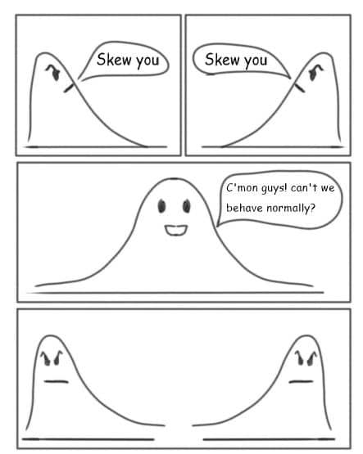

Slide 3
Learning Objectives
Decide what is an appropriate measure of central tendency and dispersion to report
Interpret the meaning of different measures of dispersion
Compute and interpret the meaning of confidence intervals

Slide 4
Descriptive Statistics
Location of a frequency distribution (central tendency)
e.g., mean, median
Where are the majority of the values located?
Is one group larger than another?

Slide 5
Descriptive Statistics
Location of a frequency distribution (central tendency)
e.g., mean, median
Where are the majority of the values located?
Is one group larger than another?
Spread of a frequency distribution (dispersion)
standard deviation, inter-quartile range
How variable are the data?
How large are differences between groups compared with variations within groups?

Slide 6


Measure of Central Tendency: Arithmetic Mean
Parameter = µ
“Sample mean” “Population mean”
Estimate =
Where
$\overline{χ}$is the mean value.
∑ means sum.
n is the number of samples.
x_{i} is the observed value for the $i^{th}$ individual.
$$\overline{x}= \frac{\sum_{i=1}^{n}{x_{i}}}{n}$$
Notes:
-most common measure of central tendency
Unbiased estimate of mu if
Measures from random sampled individuals
Measurements are independent from one another
Measures taken from a population that can be described a by a normal variable

Slide 7
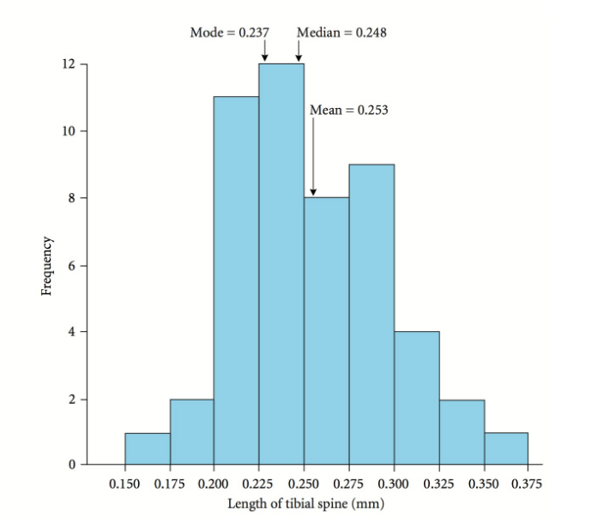
Measure of Central Tendency: Median
Aka “middle variate”
Data point where half of the values fall below and half above
Useful when sampling distribution appears non-normal

Slide 8
Measure of Central Tendency: Mode
Value that occurs most often in a dataset
Can be useful for ordinal data
For example, tumour scores

Slide 9
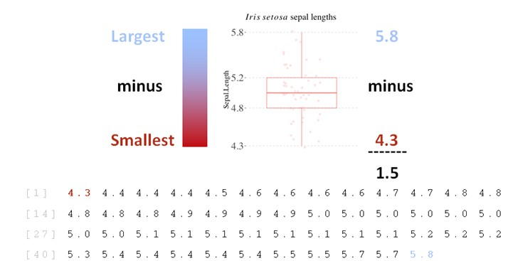
Measures of Spread: Range
Simplest measure of spread
Lowest and highest value of data
Influenced by outliers and sample size
Range of Iris setosa sepal length = 5.8 − 4.3 = 1.5.

Slide 10
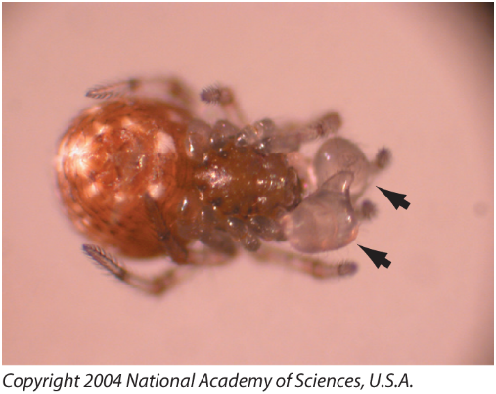
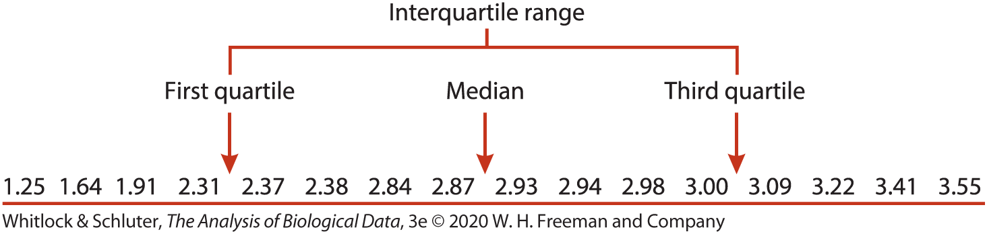
Measures of Spread: Interquartile Range
Preferred over range, less influenced by outliers
Useful for asymmetric data distributions
Partitions data into quarters
Difference between 1st and 3rd quartile
Notes:
N=16, data are from before voluntary amputation by the spiders

Slide 11
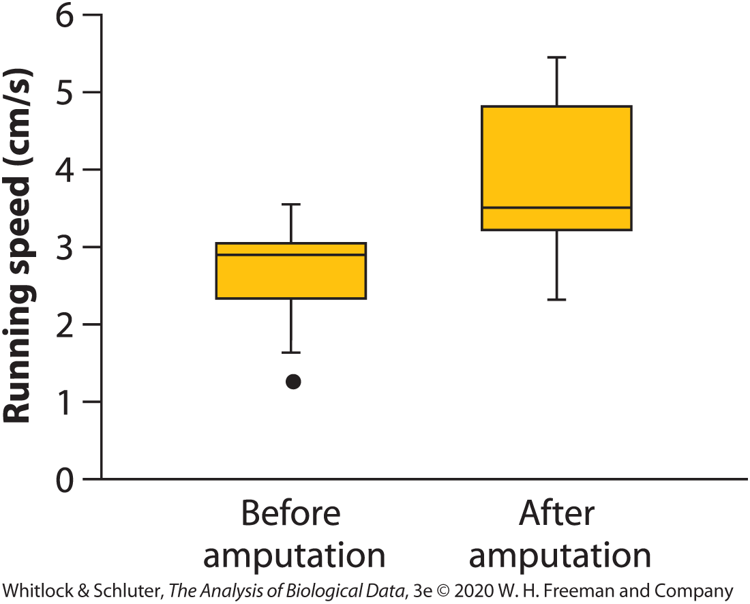
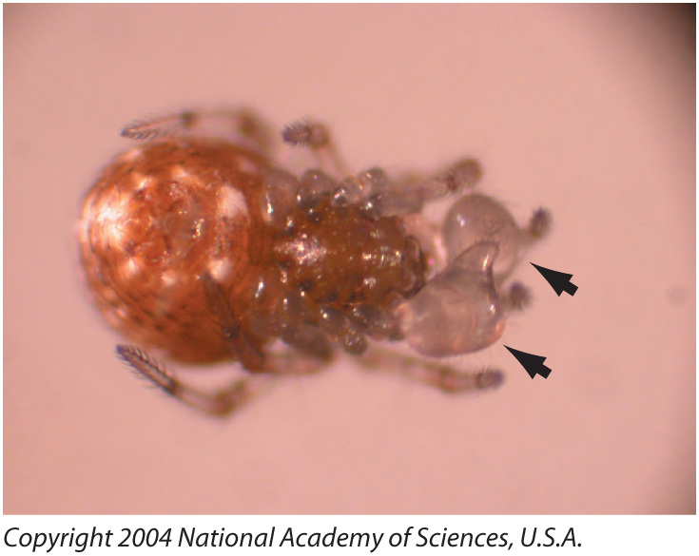
Boxplots show Median and Interquartile Range
Notes:
Whiskers stop at the smallest and largest “non-extreme” values in the data
Extreme values (outliers) lie 1.5 times beyond the interquartile range and are shown as isolated dots

Slide 12

Measures of Spread: Variance
Used to describe spread of points around mean
Important because many statistical tests aim to minimize the mean sum of squares
sum of squares
$$s^{2}= \frac{\sum_{i=1}^{n}{{\left(x_{i}−\overline{x}\right)}^{2}}}{n−1}$$
mean sum of squares
bias correction
Notes:
-variance is calculated as the difference between each observed value and the sample mean
-this difference, or deviation, is squared (otherwise the sum of deviations would add to 0 as some observations fall below and some above the average)
-the sum of the differences is called the sum of squares
-divide by n, rather than n-1 because the deviations of individual observations are calculated from the sample mean and are therefore biased towards the sample mean rather than the population mean
-the n-1 helps correct for that error and brings the sample mean closer to the population mean

Slide 13
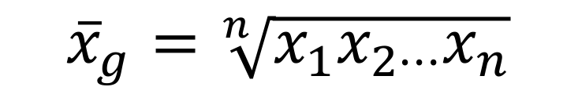
Measures of Spread: Standard Deviation
how far typical observations are from the mean
square root of the variance (s²)
same units as variable
Use to convey information about spread in original data
$$s= \sqrt{\frac{\sum_{i=1}^{n}{{\left(x_{i}−\overline{x}\right)}^{2}}}{n−1}}$$

Slide 14
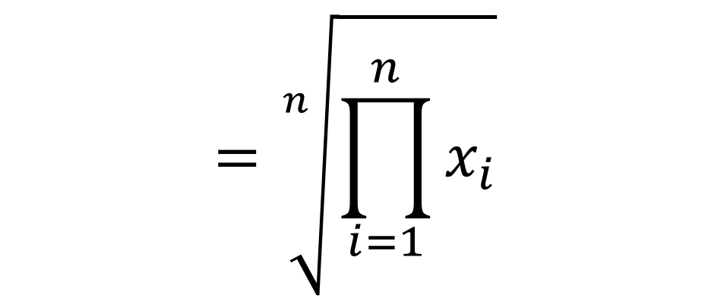
Measures of Spread: Standard Error
Measure of dispersion of a sample mean
Depends on sample size and standard deviation
Reflects ability of the sample mean to approximate the true population mean
Measure to report in most cases if data are parametric
$$s_{\overline{x}}=\frac{s}{\sqrt{n}}$$
Notes:
Smaller standard error means estimate is more precise and that there is less uncertainty in the estimate

Slide 15
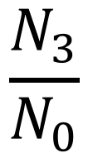
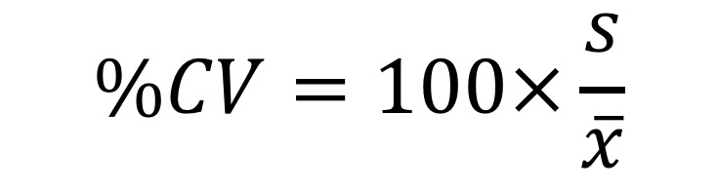
Measures of Spread: Coefficient of Variation
What if you want to compare variability
Between two means? (e.g., dolphin vs whale)
Different measurements (e.g., longevity vs body size)
$$CV=\frac{s}{\overline{x}}$$
or
$$\%CV=100×\frac{s}{\overline{x}}$$

Slide 16
Which measure of central tendency and spread to use?
Depends on shape of frequency distribution

Slide 17
Which measure of central tendency and spread to use?
Depends on shape of frequency distribution
Different measures give similar results if frequency distribution is symmetric and unimodal

Slide 18
Which measure of central tendency and spread to use?
Depends on shape of frequency distribution
Different measures give similar results if frequency distribution is symmetric and unimodal
Use mean and standard error or standard deviation if data approximate a normal distribution

Slide 19
Which measure of central tendency and spread to use?
Depends on shape of frequency distribution
Different measures give similar results if frequency distribution is symmetric and unimodal
Use mean and standard error or standard deviation if data approximate a normal distribution
Use standard error if making inference on population parameters, standard deviation if making inference on sample

Slide 20
Which measure of central tendency and spread to use?
Depends on shape of frequency distribution
Different measures give similar results if frequency distribution is symmetric an unimodal
Use mean and standard error or standard deviation if data approximate a normal distribution
Use standard error if making inference on population parameters, standard deviation if making inference on sample
Median and interquartile range make sense if data are skewed or if there are outliers

Slide 21
Which measure of central tendency and spread to use?
Depends on shape of frequency distribution
Different measures give similar results if frequency distribution is symmetric an unimodal
Use mean and standard error or standard deviation if data approximate a normal distribution
Use standard error if making inference on population parameters, standard deviation if making inference on sample
Median and interquartile range make sense if data are skewed or if there are outliers
***In publications and term projects, only present one measure of central tendency and dispersion

Slide 22
Mean or Median?
Notes:
Estimate an unknown parameter with an indication of how precise the estimate is and how confident you are that the result is correct.
-calculated as x bar = average plus or minus certain value
-where t alpha, n-1 is the critical value from the t distribution with probability p=alpha and sample size n and sx is the standard error of the mean
-upper and lower confidence intervals

Slide 23
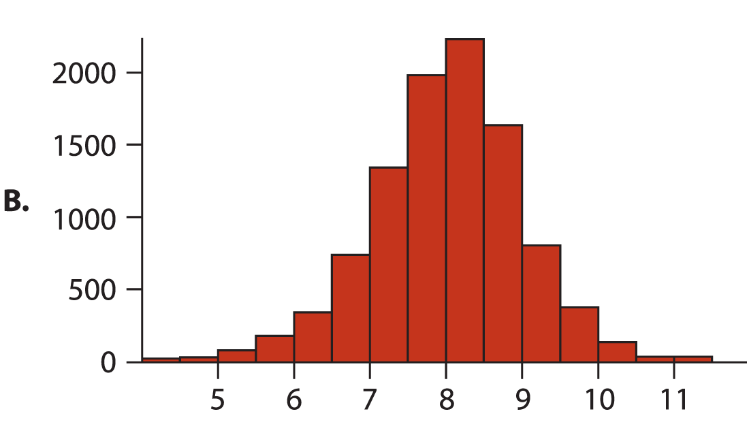
Mean or Median?

Slide 24
An absentminded friend has recently analyzed data and has two numbers: 25.4 and 2.54. Which one is the standard deviation and which one is the standard error?
What was your friend’s sample size?

Slide 25
What would you change about this table, if anything?
Treatment | Mean | Median | Min | Max | SE
A | 12.5 | 11 | 4 | 16 | 3.2
B | 16.7 | 15 | 12 | 20 | 4.1
C | 24.5 | 23 | 17 | 30 | 5.0

Slide 26

Confidence Intervals
Used to quantify uncertainty about the value of a parameter
Range of values around the sample estimate that is likely to contain population parameter
$$CI=\overline{x}±t_{α, n−1}×s_{\overline{x}}$$
Notes:
Estimate an unknown parameter with an indication of how precise the estimate is and how confident you are that the result is correct.
-calculated as x bar = average plus or minus certain value
-where t alpha, n-1 is the critical value from the t distribution with probability p=alpha and sample size n and sx is the standard error of the mean
-upper and lower confidence intervals

Slide 27
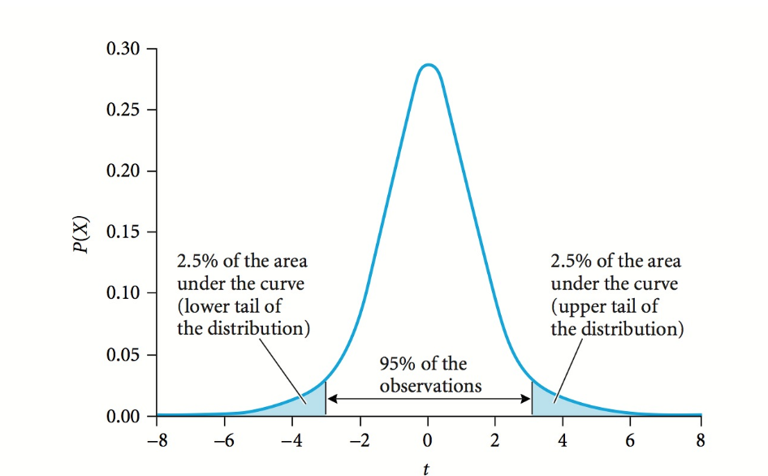

Confidence Intervals
$$t_{α, n−1}$$
Notes:
Critical value of a t-distribution with probability equal alpha and sample size n.
Confidence level is 0.95, then alpha = 0.05
The T distribution, also known as the Student’s t-distribution, is a type of probability distribution that is similar to the normal distribution with its bell shape but has heavier tails. T distributions have a greater chance for extreme values than normal distributions, hence the fatter tails.
Tail heaviness is determined by a parameter of the T distribution called degrees of freedom, with smaller values giving heavier tails, and with higher values making the T distribution resemble a standard normal distribution with a mean of 0, and a standard deviation of 1. The T distribution is also known as "Student's T Distribution."

Slide 28
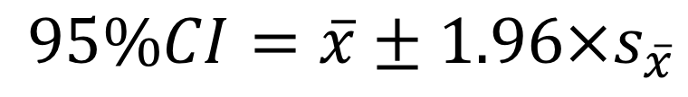

Assuming $n$is large
95% confidence interval
$$95\%CI=\overline{x}±1.96×s_{\overline{x}}$$

Slide 29
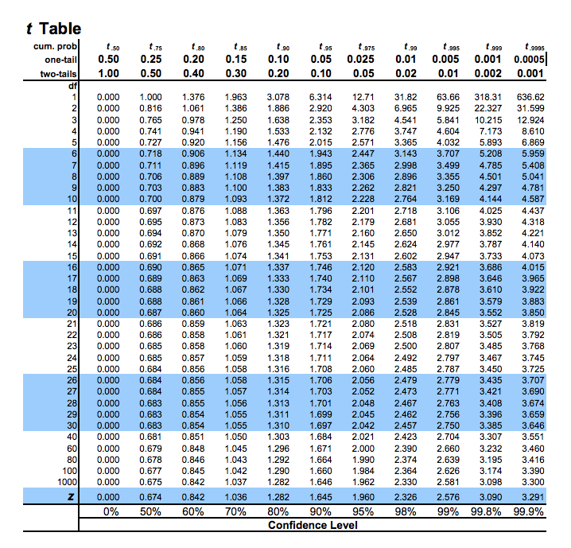
Notes:
Table source: http://www.sjsu.edu/faculty/gerstman/StatPrimer/t-table.pdf

Slide 30
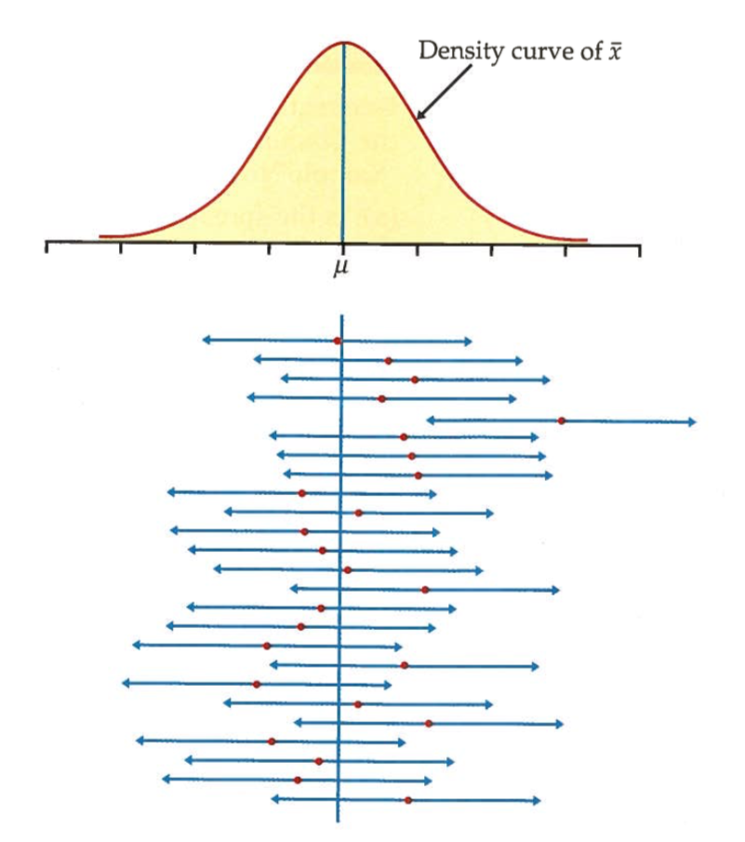


Interpretation of confidence interval
CORRECT
X% of the time, the interval will contain the true value of $μ$
INCORRECT
there is an X% chance that the true value of $μ$ occurs within the interval

Slide 31
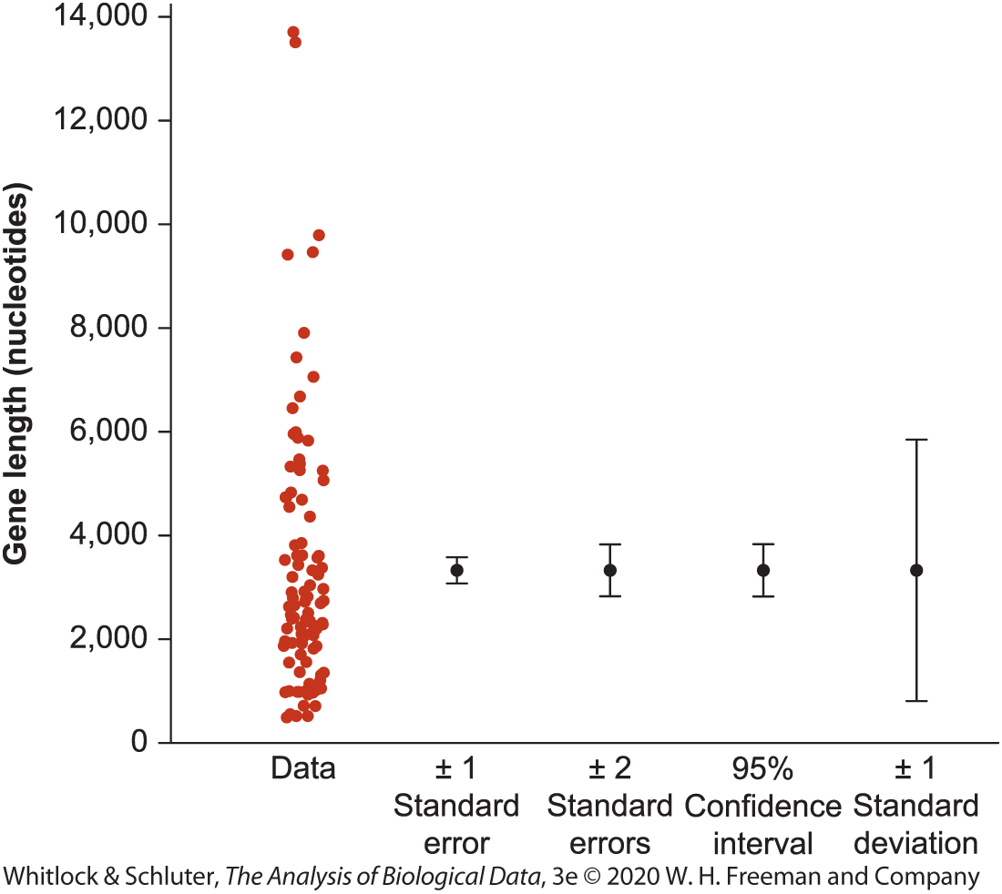
Plotting Standard Error and Confidence Intervals
Notes:
-standard error and confidence intervals are often plotted using error bar plots
-lines on a graph that extend out from a sample mean, which is shown as a dot
-these lines show the uncertainty in the estimate
-need to specify what error bars represent when you make a graph (and check when reading a graph)

Slide 32
Precision and Rounding
Retain all decimal places for calculations to avoid rounding errors
Round final results to one decimal more than measurements (e.g., measure body mass to one tenth, calculate mean of 2.567 kg, report mean as 2.57 kg)
Measures of central tendency, dispersion, and confidence intervals should have the same number of significant digits (e.g., mean = 2.57, SD = 0.34, not 0.3456
Notes:
How many significant digits to present?

